Slide 1
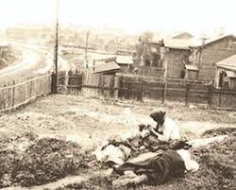
Holodomor
Famine - Genocide
in Ukraine 1932-1933
Prepared by Maria Kiciuk, PhD.
and Oksana Kulynych, Chair
U.S. Holodomor Education Committee

Slide 2
Objectives:
To examine Stalin’s reasons for the Holodomor and his policies leading to it.
To examine the nature and consequences of the Holodomor
To examine cover-up of the Holodomor
To examine the reasons behind the lack of response in the West to the Holodomor
To examine the Holodomor in the context of 20th century genocides

Slide 3
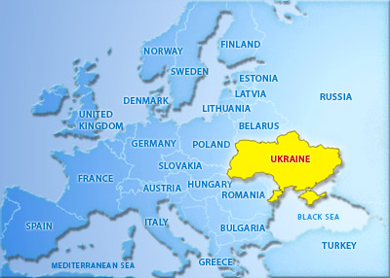
Ukraine
Largest country entirely in Europe
Capital: Kyiv
Located north of the Black Sea
Borders Poland, Belarus, Russia, Moldova, Romania, Slovakia, & Hungary
Population = 46 million
Eastern Slavic culture

Slide 4
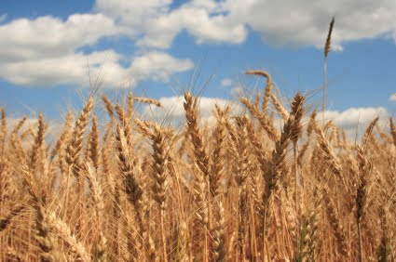
“Breadbasket of Europe”
Fertile soil provides grain to most of Europe
Notes:
Ukraine has 1/3 of the world’s black soil.
Western Ukraine comes under Polish rule

Slide 5
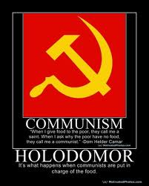
1922 - most of Ukraine forcibly incorporated into the Soviet Union

Slide 6
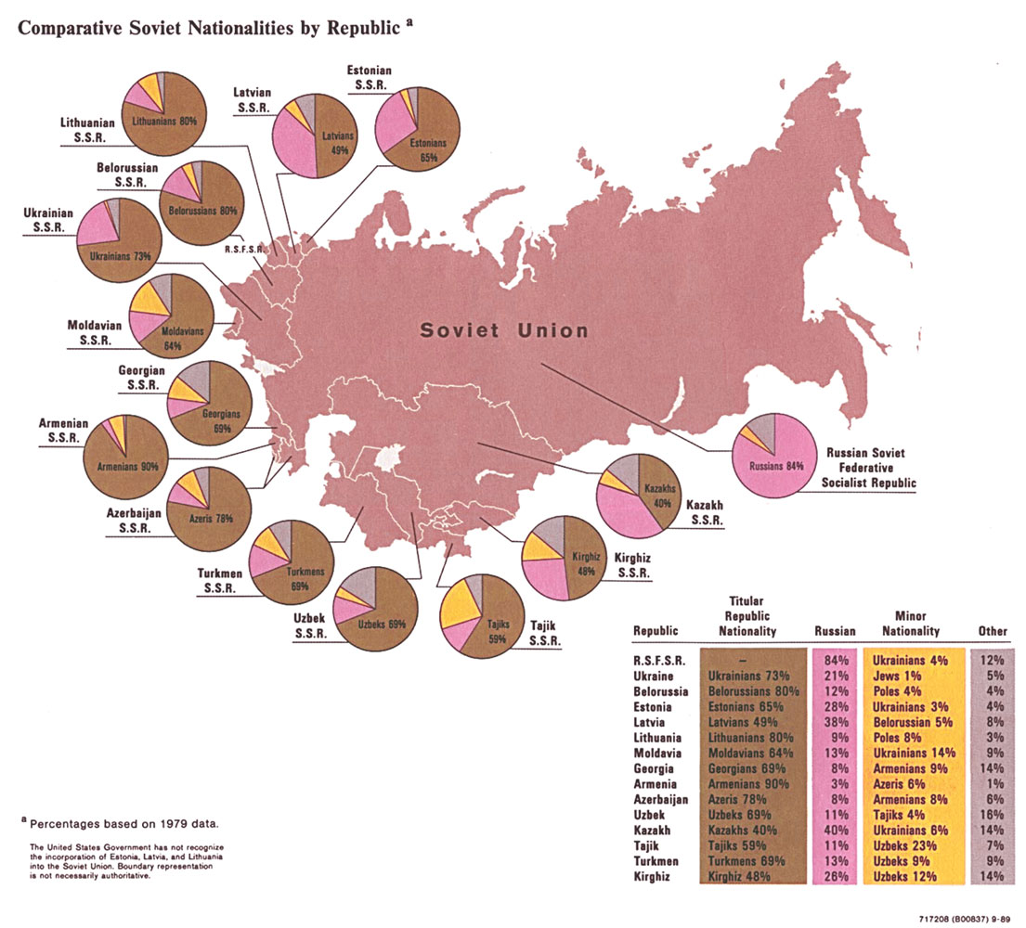

Slide 7
Stalin’s Reasons for Implementing the Holodomor
To annihilate a significant part of the Ukrainian population, openly resisting Soviet repressive policies in Ukraine
2. To terrorize the surviving Ukrainian population into submission to the Soviet totalitarian regime
3. To provide funds for Soviet industrial expansion and the purchase of machinery in the West from the sale of expropriated Ukrainian grain and other produce.

Slide 8
“If we do not begin correcting the situation in Ukraine immediately, we could lose Ukraine…The objective should be to transform Ukraine, in the shortest possible time into a veritable fortress of the USSR…Spare no money for that.”
Stalin wrote in his letter to Kaganovich, one of his henchmen responsible for the Holodomor.

Slide 9
After consolidating power over the Soviet Union, Stalin institutes the Five Year Plan 1928 - 1933
Abolish private industry
Nationalize commerce
Collectivize farms
Impose grain quotas

Slide 10
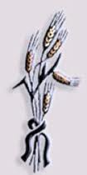
By mid 1932, nearly 75 percent of the farms
in Ukraine are forcibly collectivized.
Villagers are brought under government control.
Farmers who resisted are shot or sent to Siberia.
Collectivization: collective farms replaced
individual farms. Farmers had to surrender
their land, livestock to collective farms.
Notes:
In order to fulfill his Five Year Plan, Stalin introduces collectivization. December 27, 1929 Stalin announces a policy of “liquidation of the kulaks as a class.’’ Kulaks (kurkuls in Ukrainian) were defined as those who owned property or hired labor. By March 1930, nearly 62,000 kulak households had been eliminated.

Slide 11
"Farmers present by themselves the basic force of the national movement. Without farmers there can be no strong national movement. This is what we mean when we say that the national question is, actually, the farmers' question."
Joseph Stalin, Marxist and the National- Colonial Question
Stalin targeted the rural population - villages inhabited by ethnic Ukrainians who preserved the Ukrainian culture, language, and the spirit of independence.

Slide 12
HOLODOMOR
holod + moryty
holod = starvation
moryty = to kill
HOLODOMOR - killing by starvation
- defines a horrific tragedy in the history of mankind: the genocide committed against the Ukrainian people by the Soviet regime under Joseph Stalin
- in 1932 – 1933
Pronunciation: hau lau dau more

Slide 13
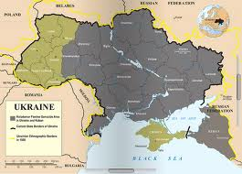
Areas affected by the Holodomor

Slide 14
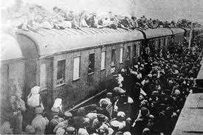
Seals Borders of Ukraine
Ukraine is the only Soviet republic whose borders are sealed to prevent food aid from entering or people from fleeing.
People attempt to board railway cars to escape
Notes:
Passportization system is instituted on December 27, 1932 denying peasants the right to move from one location to another.

Slide 15
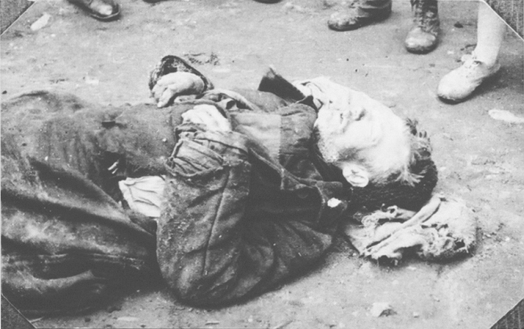
“Five ears of corn law”
August 7, 1932 imposes the death penalty or 10 years imprisonment
for theft of “socialist property”
… for picking a few ears of grain from the fields which had
previously belonged
to them.
Victim of Holodomor in Ukraine 1933
Notes:
intentional house to house searches to remove and destroy anything edible.

Slide 16
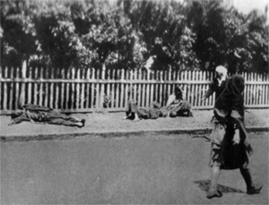
“Food is a weapon” Maxim Litinov – Soviet Commissar of Foreign Affairs
Grain quotas are increased by 44% over the
previous year.
Special brigades of communist
activists are sent in to remove
all foodstuffs from the homes
of starving villagers.
Holodomor victims on a street in Kharkiv.
Photo by Winnerberger, 1933
Notes:
Intentional house to house searches to remove and destroy anything edible.

Slide 17
Soviet Union denies the famine
Moscow refuses offers of food aid from other countries and humanitarian organizations and labels reports of a famine as anti-Soviet propaganda.
Exports enough grain from Ukraine to feed the entire population.
Foreign journalists are banned from traveling to Ukraine and North Caucasus in 1933

Slide 18
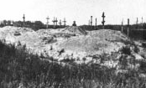
In 1933, at the height of the Famine, Ukrainian villagers were dying at the rate of:
17 per minute
1,000 per hour
25,000 per day
“The Great Famine of 1932–33 in Ukraine (Holodomor), which took
7 to 10 millions of innocent lives, became a national tragedy for the Ukrainian people”.
Joint statement by 65 UN member states, adopted by the 58th UN General Assembly on 7 November 2003
Mass graves in Soviet Ukraine, 1933

Slide 19
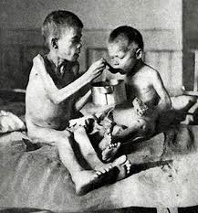
… of these 3 million were children - In desperate attempts, villagers abandoned children in urban areas which were less affected by starvation. - In late spring 1933, over 300,000 children recorded homeless in the Kyiv region.
Starving children in Soviet Ukraine 1933

Slide 20
Exact number of victims not known
Doctors were not allowed to put starvation as the cause of death
Any mention of the Holodomor was a crime against the state.
"I can't give an exact figure because no one was keeping count. All we knew was that people were dying in enormous numbers. "
Nikita Khrushchev, Khrushchev Remembers

Slide 21
Population Statistics for the Soviet Union 1926 1939
Ukrainians within USSR 31,195,000 28,111,000 - 11%
Russians in USSR 77,791,000 99,591,000 + 28%
Source: Prof. Alexander Palij, historian, Ukrainian Academy of Sciences “23 reasons for the Holodomor to be considered a genocide with no qualifications” (Ukrainian language), UNIAN, Nov. 27, 2010. http://www.unian.ua/ukr/print/40
The 1937 census revealed a sharp decrease in the Ukrainian population.
Those who conducted the census were shot and the results of the census were suppressed.

Slide 22
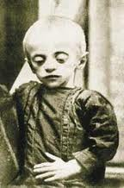
Arthur Koestler, British novelist
"I saw the ravages of the famine of 1932-1933 in the Ukraine: hordes of families in rags begging at the railway stations, the women lifting up to the compartment window their starving brats, which, with drumstick limbs, big cadaverous heads and puffed bellies, looked like embryos out of alcohol bottles ...“
Koestler spent about three months in the Ukrainian city of Kharkiv during the Famine. He wrote about his experiences in in “The God That Failed.”

Slide 23
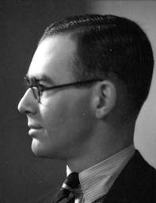
Reporters, such as Gareth Jones and Malcolm Muggeridge traveled to Ukraine in secrecy and reported on the widespread famine.
“Talked to a group of women peasants [at station]; “We’re starving. Two months we’ve hardly had bread. We’re from Ukraine and we’re trying to go north. They’re dying quietly in the villages. Kolkhozes are terrible. They won’t give us any [train] tickets and we don’t know what to do. Can’t buy bread for money.”
Gareth Jones
http://www.garethjones.org/

Slide 24
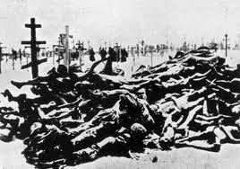
Quotation from the Harvest of Sorrow by the British historian Robert Conquest,1986
“A quarter of the rural population, men, women, and children, lay dead or dying, the rest in various stages of debilitation with no strength to bury their families or neighbors.”

Slide 25
Holodomor cripples Ukraine as a nation for many generations.
Loss of Ukrainian leaders
Loss of educated classes
economic, political, intellectual and spiritual
80% of Ukrainian intellectuals are executed
Out of 240 Ukrainian authors 200 perish, and out of 84 linguists 62 are executed
Entire villages depopulated
Russians are brought in to settle the depopulated villages
Destruction of the Ukrainian language, traditions, and the spirit of individualism and independence.

Slide 26
“[T]he assault by famine on the Ukrainian peasant population was accompanied by a wide-ranging destruction of Ukrainian cultural and religious life and slaughter of the Ukrainian intelligentsia…”
Robert Conquest. “Harvest of Sorrow” 1986

Slide 27
Definition of GENOCIDE?
…any of the following acts committed with intent to destroy, in whole or in part, a national, ethnical, racial or religious group by:
Killing members of the group
Causing serious bodily or mental harm to members of the group
Deliberately inflicting on the group conditions of life calculated to bring about its physical destruction in whole or part
Imposing measures intended to prevent births within the group
Forcibly transferring children of the group to another group
Source: the Encyclopedia of the United Nations and International Relations, New York Taylor and Frances. 1990. 328

Slide 28
Genocide of Ukrainians
A deliberate attempt to crush the Ukrainian nation as evidenced by witness accounts and laws enacted.
Not a result of a natural calamity or poor harvest. It took place in peacetime.
"...A famine that came about without drought and without war.“ Alexander Solzhenitsyn, The Gulag Archipelago
Grain is exported while the farmers who produce it are dying of starvation.
Intellectual and religious segment of the nation are destroyed through massive arrests, deportation, and firing squads.

Slide 29
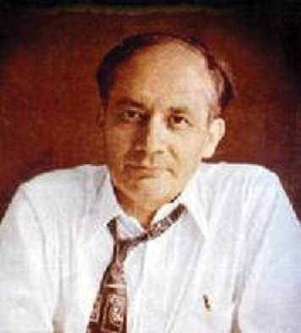
“Soviet genocide in..Ukraine”
Raphael Lemkin, who coined the word “genocide” states that the Holodomor is “a case of genocide, of destruction, not of individuals only, but a culture and a nation.”
“the classic example of Soviet genocide, its longest and broadest experiment in Russification – the destruction of the Ukrainian nation.”
Raphael Lemkin: principal author of Convention on the Prevention and Punishment of the Crime of Genocide.
Adopted by the General Assembly of the United Nations on December 9, 1948.

Slide 30
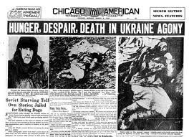
In 1988, the U.S. Congress Commission on the Ukraine Famine concluded that Joseph Stalin and those around him committed genocide against Ukrainians in 1932-1933.”

Slide 31
Why is the Holodomor virtually unknown in the West? largely ignored or denied in the West for decades
“The truth of the matter is that we have a certain amount of information about the famine conditions in the south of Russia… We do not want to make it public because the Soviet government would resent it and our relations with them would be prejudiced.”
Excerpt from UK Foreign Office document
“There is no actual starvation or death from starvation, but there is widespread mortality from diseases due to malnutrition”
Walter Duranty, New York Times, March 31, 1933,
Known as Stalin’s
apologist

Slide 32
Turning a Blind Eye
“… (Our reporting) served Moscow’s purpose of smearing the facts out of recognition and declaring a situation which, had we reported simply and clearly, might have worked up enough public opinion abroad to force remedial measures. And every correspondent each in his own measure, was guilty of collaborating in this monstrous hoax on the world.” Eugene Lyons – (Moscow United Press correspondent from 1928 to 1934) Assignment in Utopia pp.573

Slide 33
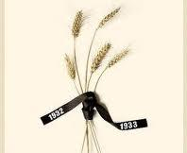
In 1934 the Soviet Union became a member of the League of Nations
In 1933, at the height of the famine, the U.S, government officially recognized the Soviet Union.

Slide 34
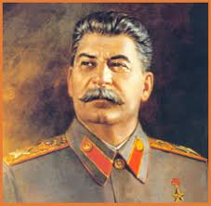
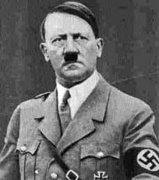
Two Murderers of the 20th century
Joseph Stalin
Adolph Hitler

Slide 35
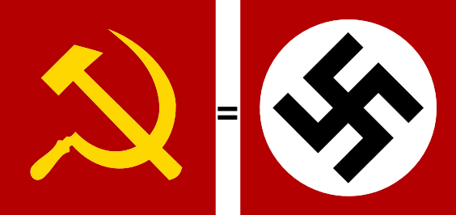
Is Communism comparable to Nazism?
Totalitarian regimes, which not only denied human rights but were also responsible for the loss of millions of lives.
At the beginning of WWII, the Soviet Union and Nazi Germany had been allies for almost two years (Molotov-Ribbentrop Pact).
“Communism and Nazism are, and always were, morally indistinguishable.”
Stephane Courtois, French historian The Black Book of Communism

Slide 36
Differences between Communism and Nazism
The Holodomor was a precursor of the Holocaust. Some historians believe that without the Holodomor, which was committed with complete impunity, the Holocaust might not have happened.
Nazi leaders were punished for the crimes they committed against humanity. Yet, no Communist leader has ever been brought to justice.
Soviet Union lasted 70 years and covered a larger land area than Nazism, affecting more people.

Slide 37
Witness testimonies
“Where did all bread disappear, I do not really know, maybe they have taken it all abroad. The authorities have confiscated it, removed from the villages, loaded grain into the railway coaches and took it away someplace. They have searched the houses, taken away everything to the smallest thing. All the vegetable gardens, all the cellars were raked out and everything was taken away. “
(From the memories of Olexandra Rafalska, Zhytomir)
“More than a half of the village population perished as a result of the famine. It was terrifying to walk through the village: swollen people moaning and dying. The bodies of the dead were buried together, because there was no one to dig the graves.”
(From the memories of Galina Gubenko, Poltava region)

Slide 38
Witness Testimonies
“In February of 1933, there were so few children left that the schools were closed. By this time, there wasn't a cat, dog or sparrow in the village.”
(Tatiana Pawlichka)
“It was forbidden for people to leave their villages. GPU guards blocked all roads and railways. Any food that the farmers happened to be carrying was taken away from them. For picking a stray head of wheat or a frozen potato or beet left in the field, a person was sentenced to ten years in prison or concentration camp.”
(Polikarp Kybkalo)
Congressional Testimony presented before the United States Ukraine Famine Commission in Washington D. C., October 8, 1986

Slide 39
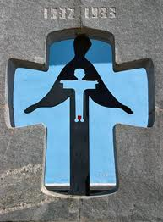
Why are Ukrainians pressing for recognition of the Holodomor as a genocide?
To pay tribute to the millions of victims
To condemn the crimes of the Soviet Communist government
To raise awareness that food is still
being used as a weapon
Help prevent such deplorable acts
from happening again
Monument to Holodomor victims in Ukraine

Slide 40
FOOD AS A POLITICAL WEAPON
20th century Communist imitators of Stalin
CHINA - regime of Mao Zedong – “Great Leap Forward Famine” of 1958- 1960 tens of millions died of starvation.
ETHIOPIA - Communist regime in 1974 - thousands, perhaps millions of people, seeking independence, starved to death while government spent millions of dollars on military armaments.
CAMBODIA - Communist Khmer Rouge in 1975 - government of Pol Pot was responsible for the death of some 2 million through a program of planned execution and forced starvation.
Notes:
The genocide by artificial famine initiated by Stalin in Ukraine in the
1930's has had many Communist imitators during the 20th century.
China was taken over by the Communist regime of Mao Zedong. During the Mao Great Famine Leap Forward of 1958- 1960 tens of millions died of starvation.
Ethiopia was taken over by a Communist regime in 1974. Under the leadership of
Mengistu Haile Mariam, thousands, perhaps millions of people, mostly Eritreans
seeking independence, were allowed to starve to death while the government spent millions of dollars on military armaments.
Cambodia was taken over by the Communist Khmer Rouge in 1975. During the
next three years the government of Pol Pot was responsible for the death of some
2 million men, women and children through a program of planned execution and
forced starvation.
The genocide by artificial famine initiated by Stalin in Ukraine in the
1930's has had many Communist imitators during the 20th century.
China was taken over by the Communist regime of Mao Zedong. During the Mao Great Famine Leap Forward of 1958- 1960 tens of millions died of starvation.
Ethiopia was taken over by a Communist regime in 1974. Under the leadership of
Mengistu Haile Mariam, thousands, perhaps millions of people, mostly Eritreans
seeking independence, were allowed to starve to death while the government spent millions of dollars on military armaments.
Cambodia was taken over by the Communist Khmer Rouge in 1975. During the
next three years the government of Pol Pot was responsible for the death of some
2 million men, women and children through a program of planned execution and
forced starvation.
Afghanistan was invaded by the Soviet Union in 1979. Unable to subdue the
Afghan countryside, the Soviets began a program of genocidal suppression which
included "killing of the civilian support population, terrorizing and driving of the
survivors, and creating famine conditions

Slide 41
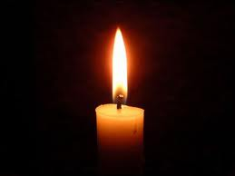
Only by understanding the genocides of the past, can we hope to prevent others from occurring in our lifetime.

Slide 43
Genocide in Ukraine Graphic organizer
State four basic reasons 3. State four basic facts describing why the how the Holodomor occurred.
Holodomor occurred.
2. What were four consequences 4. Express in verbal or
of the Holodomor? graphic form the most
potent mental picture you have of the Holodomor.
“Genocide Never Again” Curriculum 2007

Slide 44
Sources
Case Studies: Persecution/Genocide the Human Rights Series. Vol. III. : The University of the State of New York the State Education Department, 1986. Print.
Dolot, Miron. Execution by Hunger: The Hidden Holocaust: A Survivor’s Account of the Famine in the Soviet Ukraine 1932-1933: A Memorial Exhibition. Cambridge: Widener Library Harvard University, 1986. Print.
Ferrell, Robert H., ed. The Twentieth Century: An Almanac. New York: World Almanac Publication, 1985. Print.
Famine of 1932-1933 in Ukraine. New York: WW. Norton & Company, 1985. Print.
Harvest of Sorrow: Soviet Collectivization and the Terror-Famine. New York: Oxford University Press, 1986. Print.
Hunczak, Taras, and Roman Serbyn. Famine in Ukraine 1932-1933: Genocide by Other Means. Shevchenko Scientific Society,
2007. Print
Klid, Bohdan, and Alexander Motyl. The Holodomor Reader: A Sourcebook on the Famine of 1932-1933 in Ukraine. Canadian Institute of Ukrainian Studies, 2012. Print.
Lemkin, Raphael. “Soviet Genocide in the Ukraine.” New York City. 1953. Speech.
Mace, James E., and Leonid Heretz, eds. Commission on the Ukrainian Famine. Oral History Project of the Commission on the Ukraine Famine. Washington D. C.: Supt. of Doc, U.S. G.P.O, 1990. Print.
“Murder by Hunger.” The Wall Street Journal [New York] 10 Jan. 1985: Print.
Panne, Jean-Louise, et al. The Black Book of Communism: Crimes, Terror, Repression. Ed. Mark Kramer. Trans. Jonathan Murphy. Cambridge: Harvard University Press, 1999. Print.
Snyder, Timothy. Bloodlands: Europe between Hitler and Stalin. New York: Basic Books, 2010. Print.
Taylor, S. J. Stalin’s Apologist: Walter Duranty, The New York Times Man in Moscow. New York: Oxford University Press, 1990. Print.
Websites
Famine-Genocide in Ukraine 1932-1933. Web. <http://www.faminegenocide.com>. Bibliographies, lesson plans, testimonies, memoirs, etc. for students and educators.
Holodomor 1932-33. Web. <http://www.holodomorct.org>.
Ukrainian Genocide of 1932-1933. Ukrainian Genocide Famine Foundation USA-Inc. Web. <http://www.ukrainiangenocide.org>.

Slide 45
DVD/ Video
Harvest of Despair. Prod. Ukrainian Famine Research Committee St. Vladimir’s Institute. 1985. Yevshan Corporation. DVD.
Snores, Edwin, dir. The Soviet Story. 2008. Perry Street Advisors. DVD.
Luhovy, Yurij, dir. Genocide Revealed,2011. La Maison de Montage Luhovy Inc. DVD “Best Historical Film 2011”, “ Best Documentary 2011”
Curriculum Guides
Bej, Vera, Ihor Mirchuk, and Christine R. Shwed. Genocide Never Again [Ukrainian Genocide], 2007. Print. Teacher and student workbook. Includes applicable Pennsylvania standards & eligible content by worksheets. Grades 7+.
Babij, Lana, Lidia Choma, and Borys Krupa. Turning a Blind Eye: A Unit of Study, 2012. Print. A classroom ready unit designated for high school curricula; presents the Holodomor, China’s 1959-61 Famine, Darfur and selected current events in terms of “recognizing, acknowledging, and exposing human rights violations and genocide, with a special focus on media and social responsibility.”
Kuropas, Myron B., and James Mace. The Ukrainian Genocide/Holodomor, 1932-1933. Print. A Curriculum and Resource Guide for Educators developed for the State of Illinois, which mandates the study of “the Famine-Genocide in Ukraine”, updated through 2008.
Kuryliw, Valentina. The Unknown Genocide - Ukrainian Holodomor 1932-33. Print. Award- winning Canadian educator authored lesson plans, links, and bibliography for grades 10-12. Revised edition forthcoming.

